Slide 1
Finding Acronym Definitions in Unstructured Text (using backreferences in regular expressions)
Bob Horton
Microsoft

Slide 2
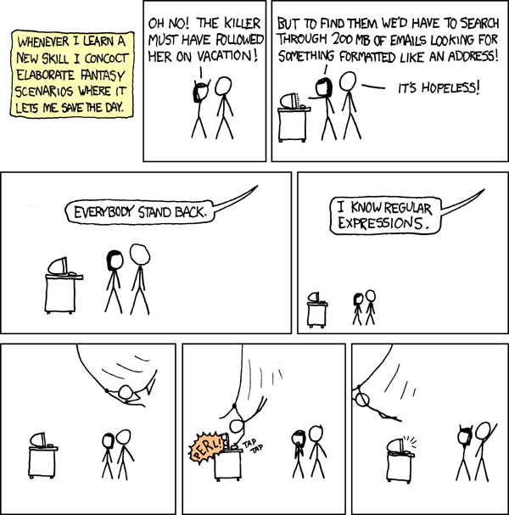
xkcd.com

Slide 3
Some people, when confronted with a problem, think "I know, I'll use regular expressions."
Now they have two problems.
- Jamie Zawinski

Slide 4
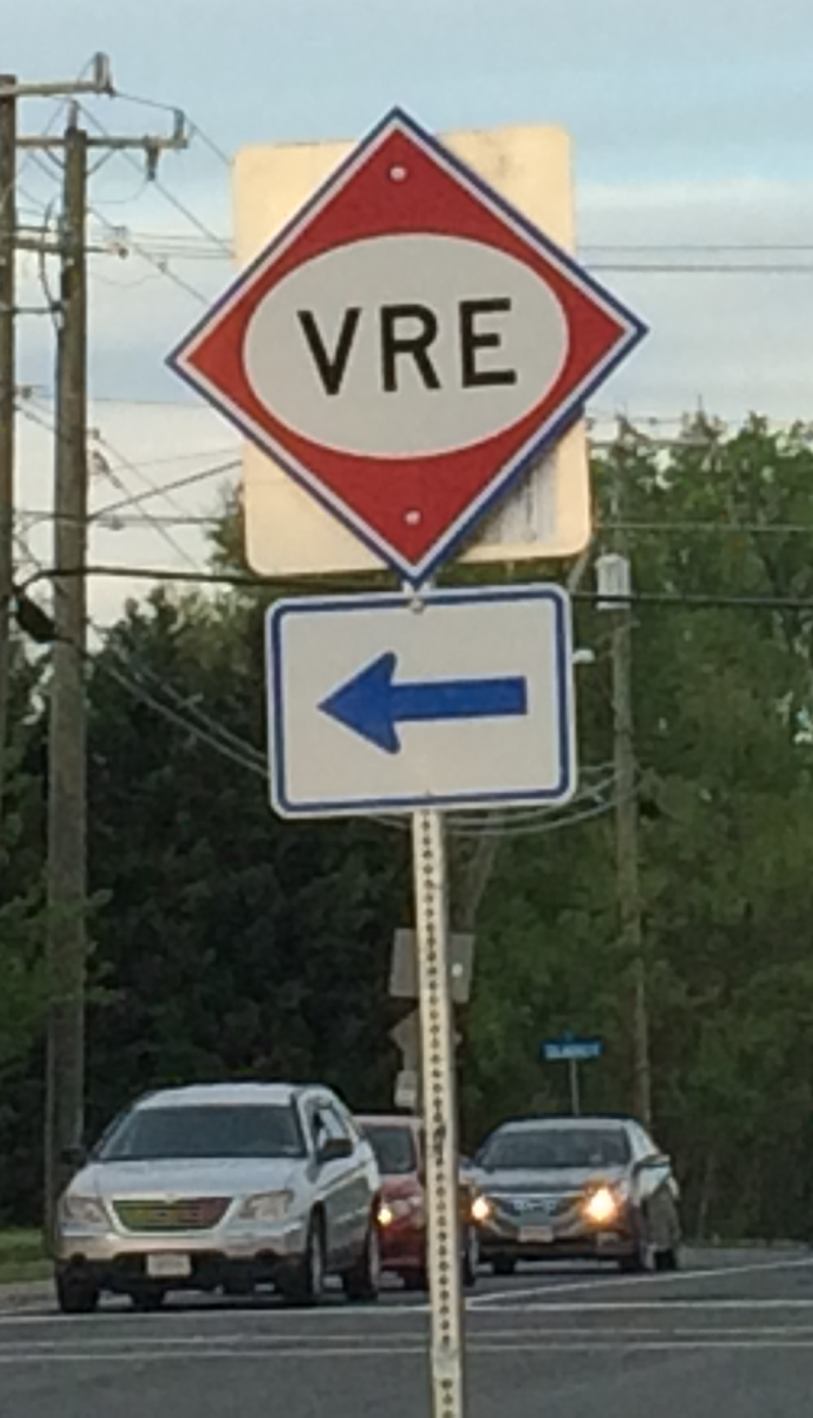
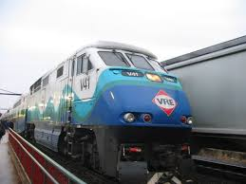

Slide 5
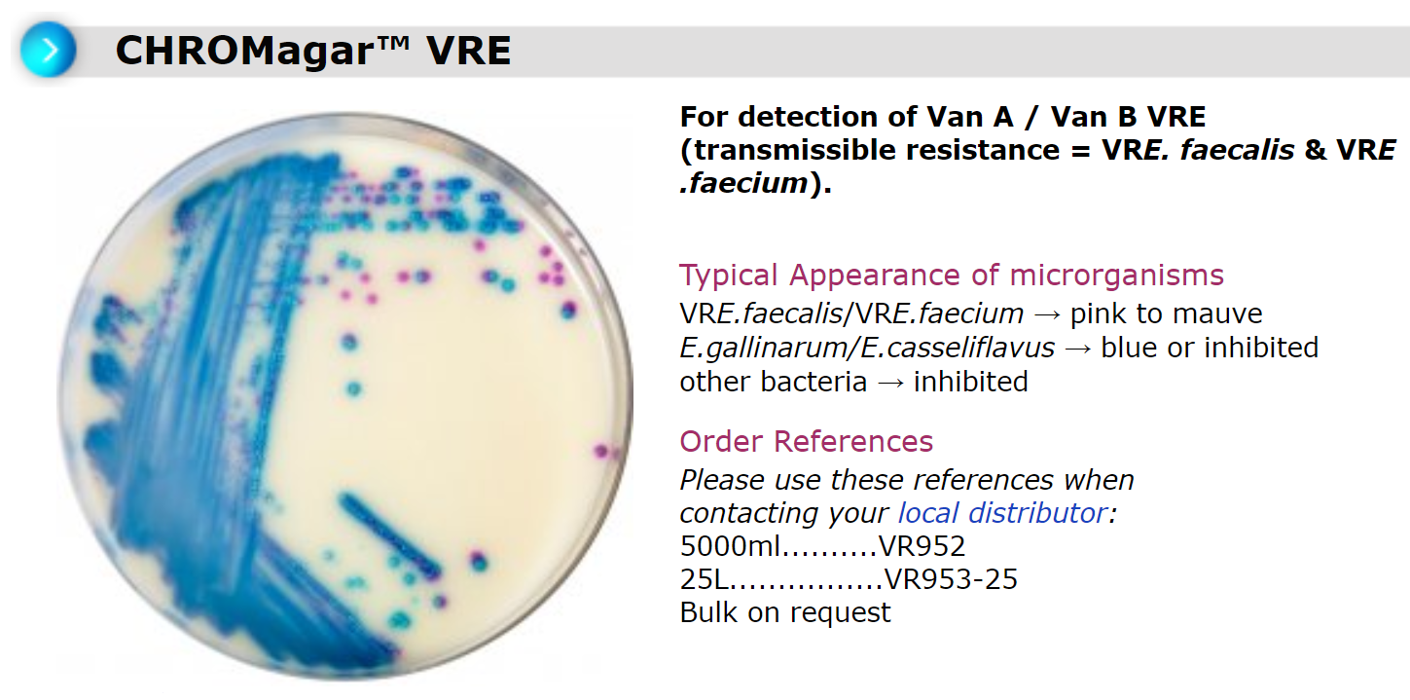
What is vancomycin-resistant enterococci?
Enteroccocci are bacteria that are normally present in the human intestines and in the female genital tract and are often found in the environment. These bacteria can sometimes cause infections. Vancomycin is an antibiotic that is used to treat some drug-resistant infections caused by enterococci. In some instances, enterococci have become resistant to this drug and thus are called vancomycin-resistant enterococci (VRE). Most VRE infections occur in hospitals.
cdc.gov

Slide 6
Bonus Slides
Code from the talk

Slide 7
tla_pat <- "(([A-Z])[a-z']+(?: |,|&|and|of|-)+([A-Z])[a-z']+(?: |,|&|and|of|-)+([A-Z])[a-z']+) ?\\(\\2\\3\\4\\)"
grepl(tla_pat, "Three-Letter Acronym (TLA)")

Slide 8
library(dplyr)
find_acronyms_of_length <- function(num_terms, txt){
# Find full names followed by abbreviation in parentheses
# Assemble acronym pattern for specified number of terms:
terms_pat <- paste(rep("([A-Z])[a-z']+", num_terms),
collapse='(?: |,|&|and|of|-)+')
backref_pat <- paste0('\\', (1:num_terms) + 1, collapse='')
acronym_pat <- sprintf('(%s) ?\\(%s\\)', terms_pat, backref_pat)
# Use the pattern to extract occurrences from the text:
txt %>%
gregexpr(acronym_pat, ., perl=TRUE, ignore.case=TRUE) %>%
regmatches(txt, .)
}
Notes:
Using `ignore.case=TRUE` lets us match examples where the acronym, or the terms in the full name are not capitalized. If you want to ignore case between the backreference and the initial letter, you need to use `perl=TRUE`.

Slide 9
get_acronyms_table <- function(text_vec, acronym_lengths=2:6){
text_vec %>%
lapply(acronym_lengths, find_acronyms_of_length, .) %>%
unlist %>% gsub('\\)$', '', .) %>%
strsplit(' ?\\(') %>% do.call(rbind, .) %>%
as.data.frame(stringsAsFactors=FALSE) %>%
setNames(nm=c('full', 'abbr')) %>%
mutate(normalized_name=full %>% gsub(',|&|and|of|-', '', .) %>%
gsub(' +', ' ', .) %>% tolower ) %>%
group_by(normalized_name) %>% top_n(n=1, wt=nchar(full)) %>%
arrange(normalized_name, -nchar(full)) %>% slice(1) %>%
ungroup %>% select(abbr, full)
}

Slide 10
library(rvest)
library(xml2)
"https://en.wikipedia.org/wiki/Acronym" %>%
xml2::read_html() %>%
html_text %>%
get_acronyms_table(acronym_lengths=2:8) %>%
as.data.frame

